Slide 1
Risk Analysis for Medical Device Systems of Systems
Process & tools for safety guided design
Hariharan Thiagarajan
John Hatcliff
Robby
Kansas State University
Joint work with Adventium Labs
Supported in part by the US National Science Foundation FDA Scholar-in-Residence Program and the US Department of Defense
Notes:
Good afternoon, I am hariharan, my talk in about Risk analysis for emerging medical devices

Slide 2
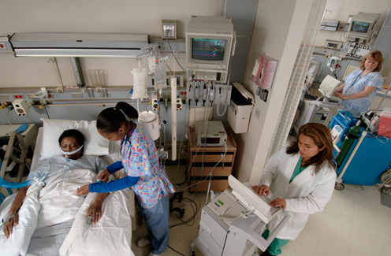
Trends In Medical Devices
In the past, health care involved a variety of system components.
Unfortunately, these components are largely un-integrated. Therefore, lacks automated solutions.
Sensor Data Displays
Clinicians
Actuators
Information Systems
Patient !
Sensors
Notes:
In the past a typical a health care environment, consists of various medical devices such as
sensors like pulseox, measures the oxygen saturation level,
Actuators, infusing drug through iv line, , info systems, clinicians
The are largely stand alone systems and they require human intervention
And they lack automated solution

Slide 3
Trends In Medical Devices
In the past, what we did well
Design & Develop stand-alone devices
Lot of experience and examples
Applied model driven development techniques
Well established techniques for logging and reporting
Clear and simple protocol for care givers
Also applied formal methods
Notes:
Continue from the previous slide : but these are simple to design and develop
In stand-alone devices: We know how to develop and analyze efficiently
Model driven development
Protocols for users around these devices
And formal methods

Slide 4
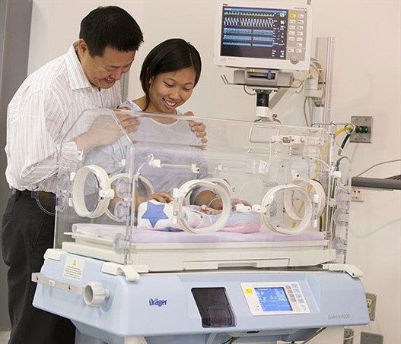
Trends In Medical Devices
Current systems with the available development technologies
Isolette: Infant incubator used to warm and monitor new born babies
Large-scale systems are challenging
Sensor Data Displays
Sensor and actuator to control the air temperature
Notes:
Today, we have integrated systems like Isolette incubator
Consists of snesors and actuators
Developed by a single manufactrer, and they are able to validate with existing techniques
But still, large systems are becoming challenging

Slide 5
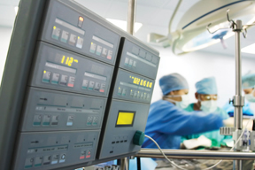
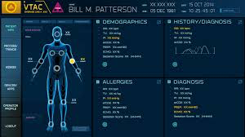
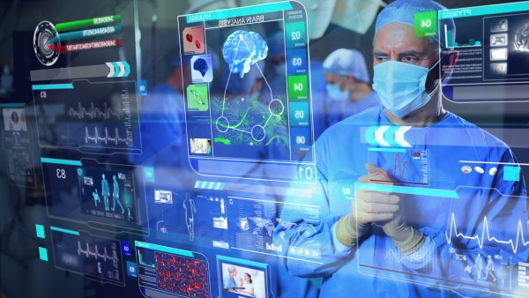
Trends In Medical Devices
What does the future look like?
Heterogeneous systems
Components of the system are produced by multiple vendors
Platform based systems
Interoperability of devices
Notes:
Multiple stakeholders
Device manufactures
App developers
System integrator
Certification authorities

Slide 6
Trends In Medical Devices
Platforms as Innovation Enablers
Consumer
Safety-Critical,
Real-Time
…
Provide infrastructure to facilitate development of multiple applications
Sensors/Actuators (often exchangable) associated with the domain
Hosting of application functionality
Services to aid communication, sandboxing of applications, interfacing, dynamic enforcement of access policies, etc.
How might platform concepts be used in the medical space?
Notes:
Phone platforms
apps
various devices
sandbox
access policies

Slide 7

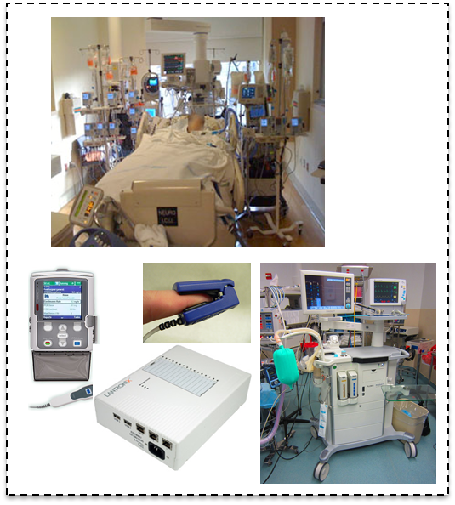
Challenges: Risk Management
Systems of systems risk management
Safety critical
Security critical
Real time
Designing platform based system from the safety standpoint
Develop risk management process and tools

Slide 8


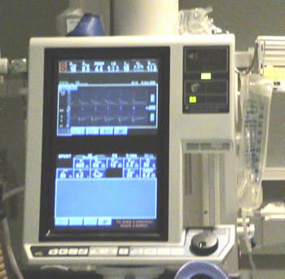
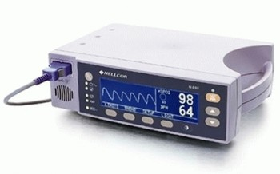
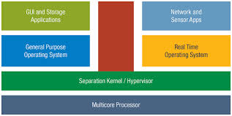
Challenge: Multiple Stakeholders
Different categories of stakeholders will be contributing products and/or risk management information that must be reused by others.
Needs:
How to document hazard analysis and risk control information at product boundaries?
How to present risk management information that are understood and reused by other organizations?
App Developers
Deployment Organizations (“Customers”)
Interoperable medical device manufacturers
Platform Providers
Notes:
Regardless of the domain, supporting development of CoD platform-based systems requires an ecosphere of cooperating stakeholders.
Any over-arching CPS architecture effort must develop a framework for such an ecosphere including roles,
responsibilities, processes, and allocation of assurance tasks across the ecosphere.

Slide 9

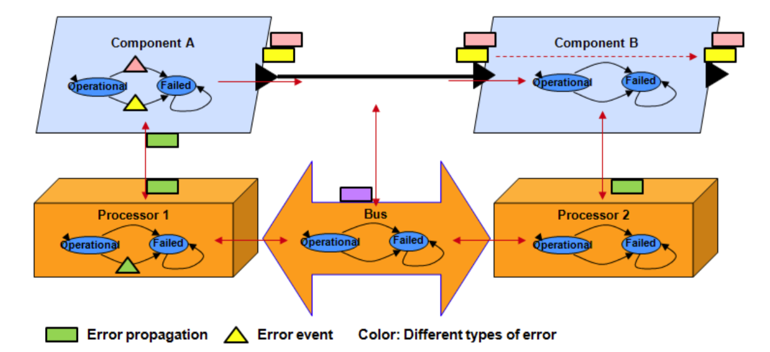

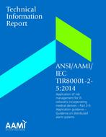
Focus of This Talk
Enabling existing model based engineering technology
AADL
+
EMV2
AWAS
Providing tools for incremental design and risk management
Design
Decisions
Risk
Management
Generating reports for strict emerging interoperable medical device standards
ANSI/AAMI IEC80001
ISO 14971
Notes:
Interoperable system design
Specification of risk management properties
7mins

Slide 10
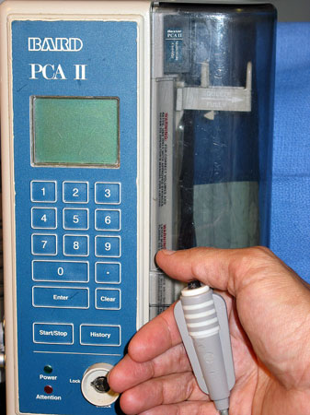
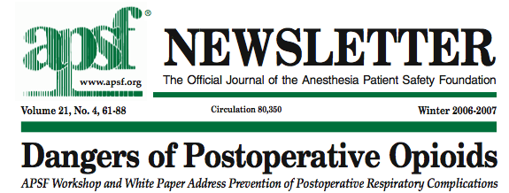
Motivation for Integrated Medical Devices
Example Use-Case: PCA Pump
Patients are commonly given patient-controlled analgesics after surgery
Crucial to care, but numerous issues related to safety
A 49-year old woman underwent an uneventful operation (total abdominal hysterectomy and bilateral salpingo-oophorectomy). Postoperatively, the patient complained of severe pain and received intravenous morphine sulfate in small increments. She began receiving a continuous infusion of morphine via a patient controlled analgesia (PCA) pump. A few hours after leaving the PACU [post anethesia care unit] and arriving on the flow, she was found pale with shallow breathing, a faint pulse, and pinpoint pupils. The nursing staff called a "code", and the patient was resuscitated and transferred to the intensive care unit on a respirator. Based on family wishes, life support was withdrawn and the patient died. Review of the case implicated a PCA overdose. Delayed detection of respiratory compromise in patients undergoing PCA therapy is not uncommon because monitoring of respiratory status has been confounded by excessive nuisance alarms.
Notes:
10
Why to integrate Medical devices ?
Motivating scenario, This device on the right is a PCA pump, used for pain management. When ever the patient press the button
Morphine is infused in to patient, and there is a risk of over dosing the patient.
There were several accidents due to this device. Here is one example, where this women is overdosed and died
There is no way for the pump to know the health status of the patient.

Slide 11
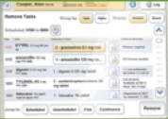
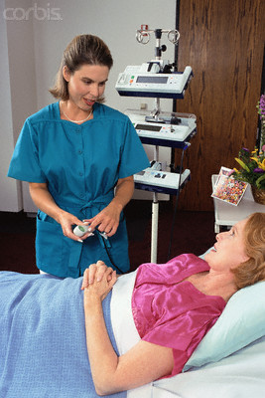
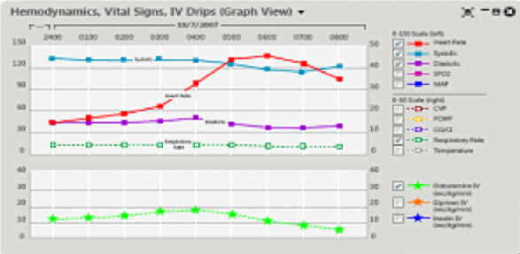
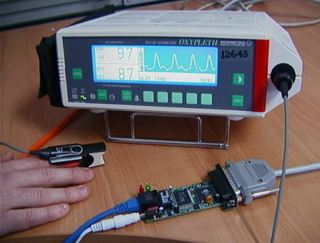
Medical Systems of Systems : PCA Interlock
There can be platforms for integrating medical devices into interoperable systems – system of systems of medical device, medical IT systems, and infrastructure components
Patient
Parameters
Devices
EMR Database
PCA Pump
Dosage
Calculator
Clinician /
Monitoring
Pain & Sedation
Scores
Pump Settings
Enable Pump
for safe time window
Enable bolus dose only when ticket present
Device Task controller
Respiratory Rate
Monitor
Monitoring Data +
Alarm Information
PCA Bolus “Enable”
Ticket
Combined PCA Vitals
Monitoring
Status Display
for PCA Monitoring
Application
Aggregated
Monitoring Status
Pulse Oximeter
Monitoring Data +
Alarm Information
Medical Application Platform(MAP) &
Application hosting infrastructure
Notes:
Two monitoring devices, to monitor the patient’s health
is this system safe?

Slide 12
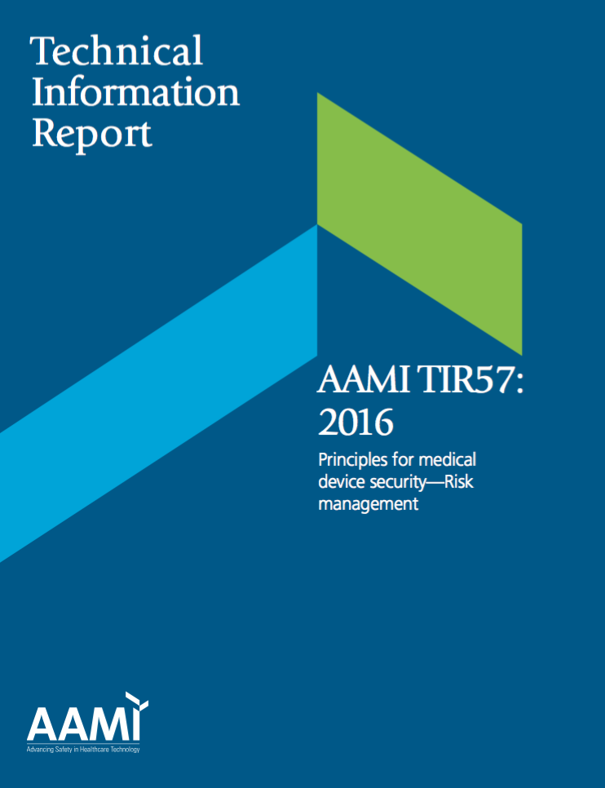
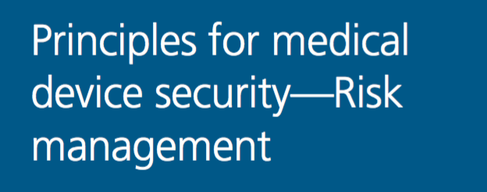
Risk Management Background
What are the existing standards and processes in the medical domain that are used for risk management and that drive the design/assurance of safety?
We will see that the concepts and processes need to be enhanced to support interoperable devices and systems.
Notes:
80001 integrated medical devices

Slide 13
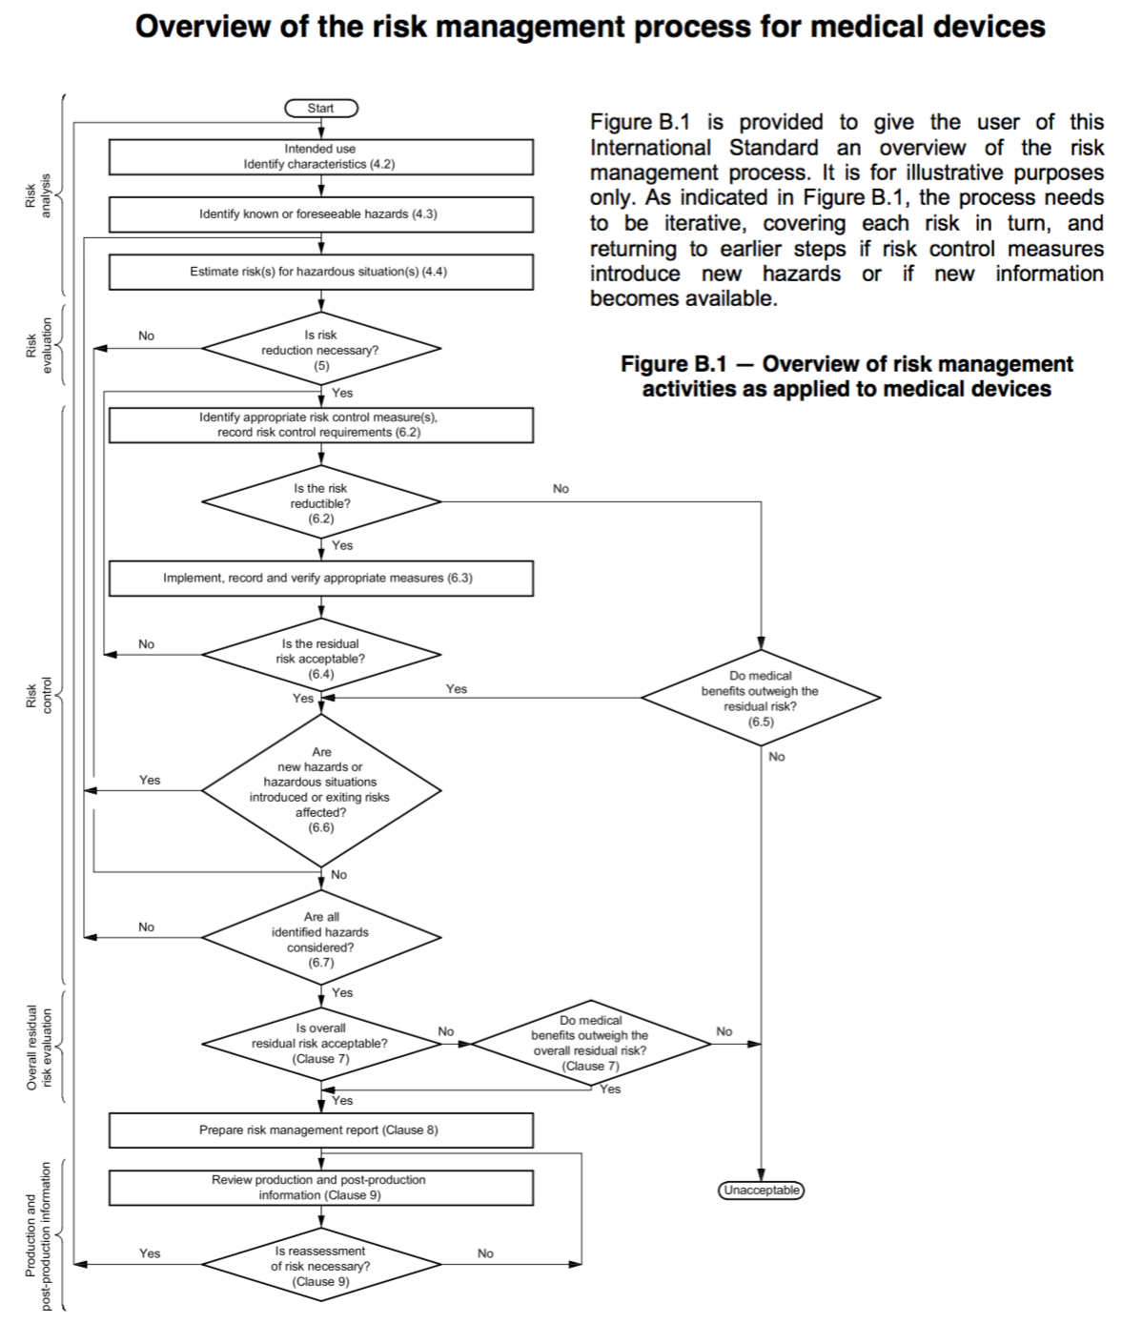
ISO 14971 Process Flow
ISO 14971 is the canonical risk management standard for medical devices
What is the purpose of my device (intended use)?
How might it cause harms (hazards, hazardous situations)?
What is the likelihood of occurrence and severity of harm (risk) of each situation?
Risk Analysis
Risk Evaluation
For each situation, is the risk acceptable?
Risk Controls
How are risks mitigated? (e.g., eliminated through design, mitigated by designed controls, mitigated with operator assistance via labelling/instructions for use)
Overall Risk Evaluation
What is the residual risk after controls are in place, and is that risk acceptable?
Notes:
12 mins

Slide 14
Focus of This Talk
Enabling existing model based engineering technology
Interoperable system design
Specification of risk management properties
AADL
+
EMV2
AWAS
Providing tools for incremental design and risk management
Design
Decisions
Risk
Management
Generating reports for strict emerging interoperable medical device standards
ANSI/AAMI IEC80001
ISO 14971
Notes:
---

Slide 15
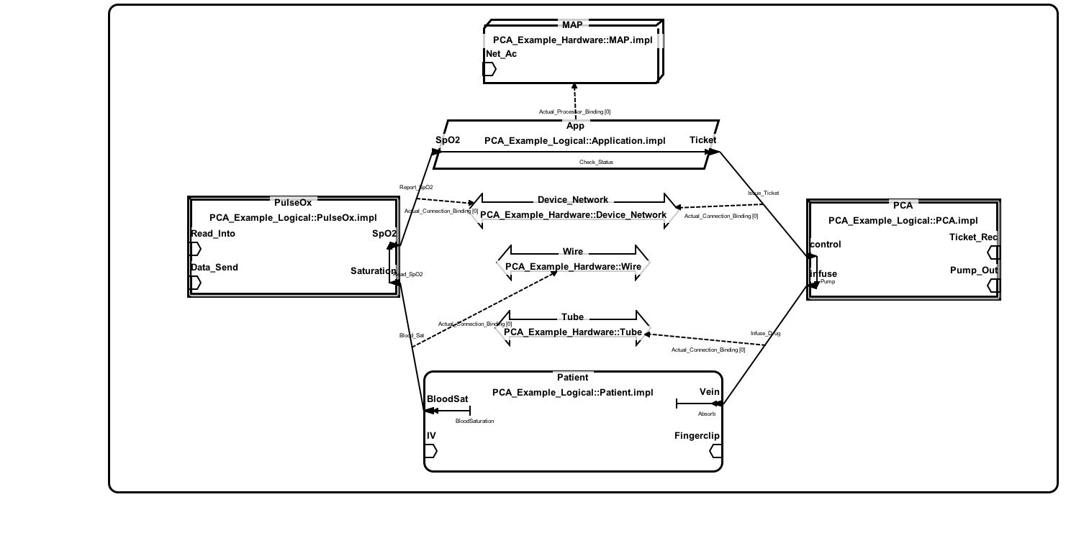
Enabling Existing MBE
Why AADL + EMV2?
Platform: MAP
Medical Application Platform &
Hosting infrastructure
Architecture Analysis and Design Language
Formal model Architecture
Model and analyze systems of systems
Software: App
Computes a ticket value based on SpO2 from PulseOX
Sensor: PulseOX
Senses blood oxygen saturation level from the patient
Connection:
Realized by an IV Line

Slide 16
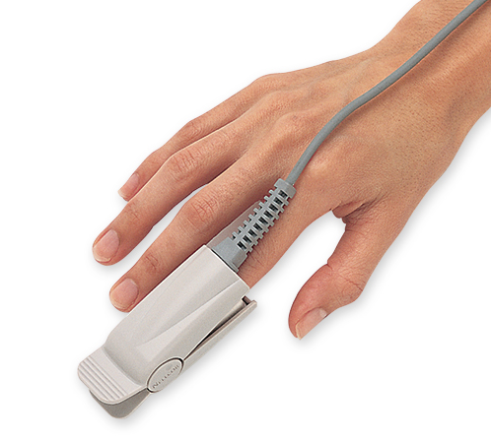
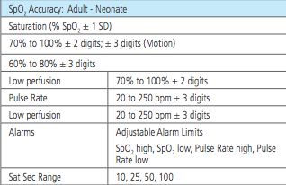
Enabling Existing MBE
Why AADL + EMV2?
Error Modeling Version 2
Classify violation of specifications into abstract failure domains
PulseOx
HighSpo2
p1
p2
Early
Error Propagation
port
Capture error propagation
Static analysis tools for automated hazard analysis
Component
C
Successor
Component
Late
ValueError
p1
p2
In
Late
Error Propagation
port

Slide 17
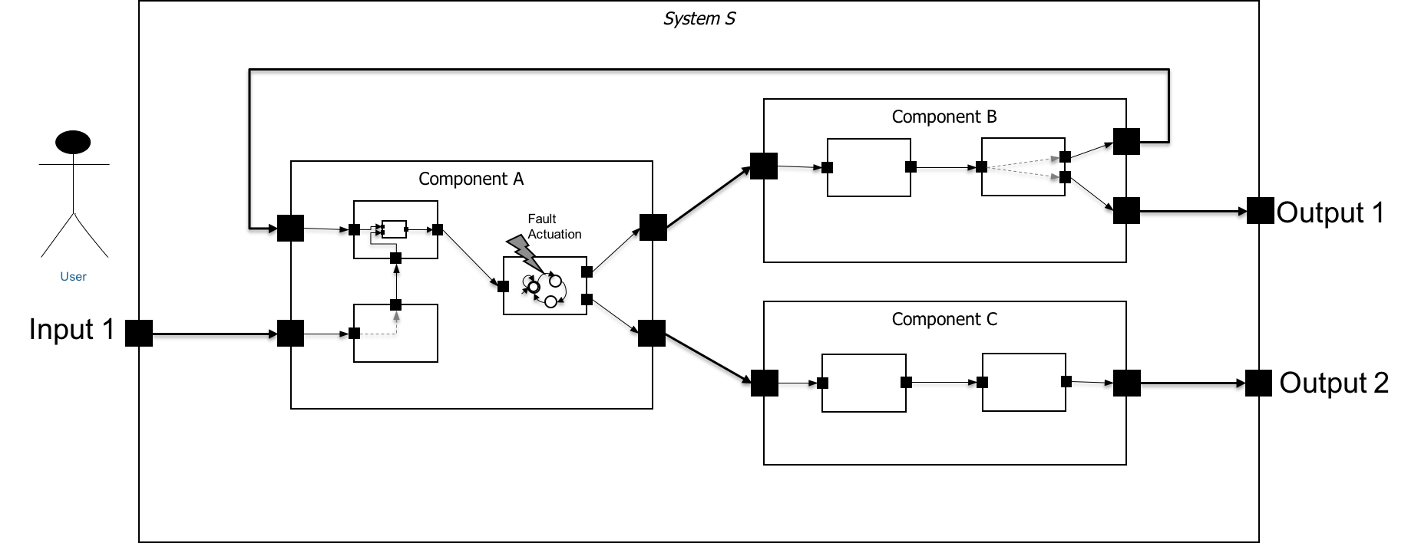
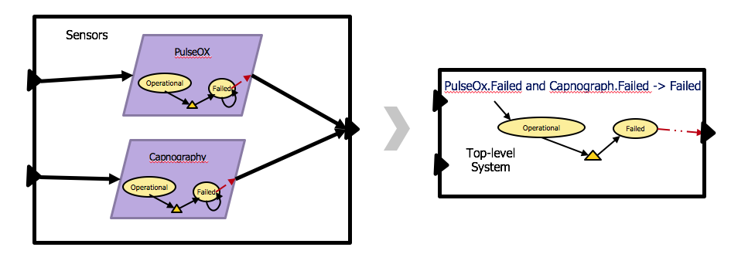
Enabling Existing MBE
Why AADL + EMV2?
Design systems of system
Specification of failure mode state machine
Compositional Analysis
Explicit state model checkers
Domain specific analysis

Slide 18
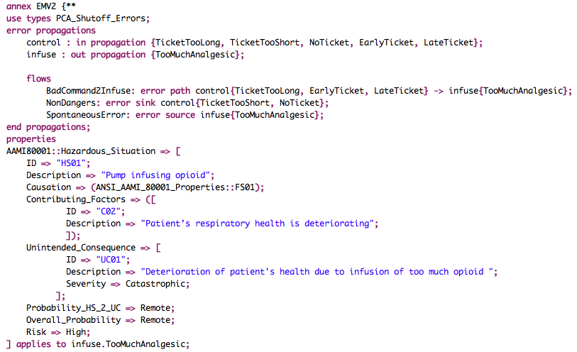
Enabling Existing MBE
Documenting hazardous situation and risk controls
Hazardous situation
Pump infusing higher levels of drug
What can we do with our
model + specific
fault information?

Slide 19
Focus of This Talk
Enabling existing model based engineering technology
Interoperable system design
Specification of risk management properties
AADL
+
EMV2
AWAS
Providing tools for incremental design and risk management
Design
Decisions
Risk
Management
Generating reports for strict emerging interoperable medical device standards
ANSI/AAMI IEC80001
ISO 14971

Slide 20
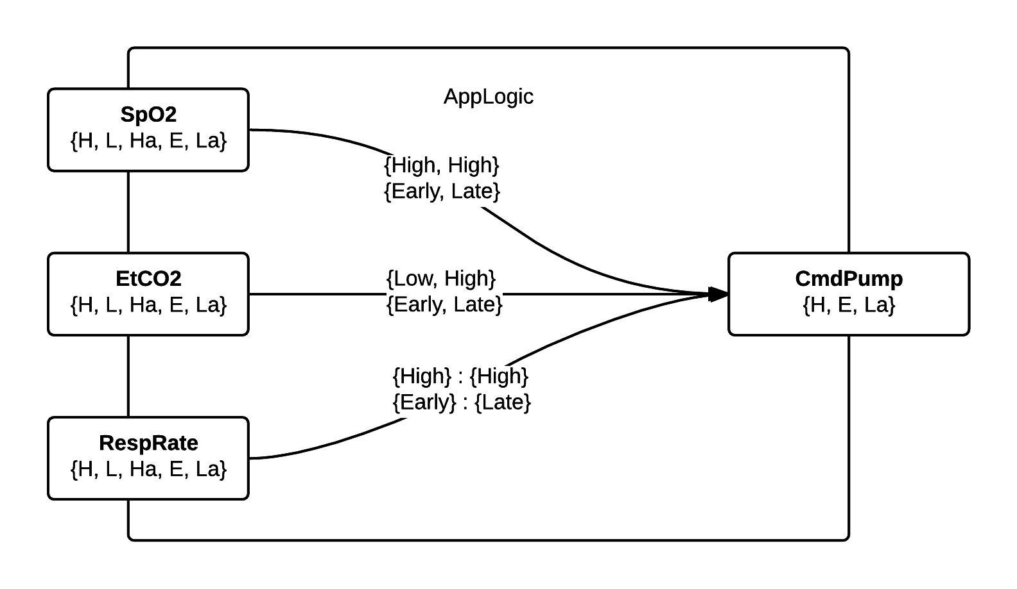
Tools: Incremental Analysis
Domain specific tool support
Incremental design & analysis
Hazard analysis as graph reachability
Design
Decisions
Risk
Management
PulseOx
SpO2_logic
Pulse
Patient
EtCO2_logic
Abstract
Design Concept
Capnography
PcaApp
CapMeasure
RR_logic
IVLine
Pump
App_Pump
Increasing levels of
Specification with Intra
Component flows
Detailed Error
behavior
Notes:
18

Slide 21
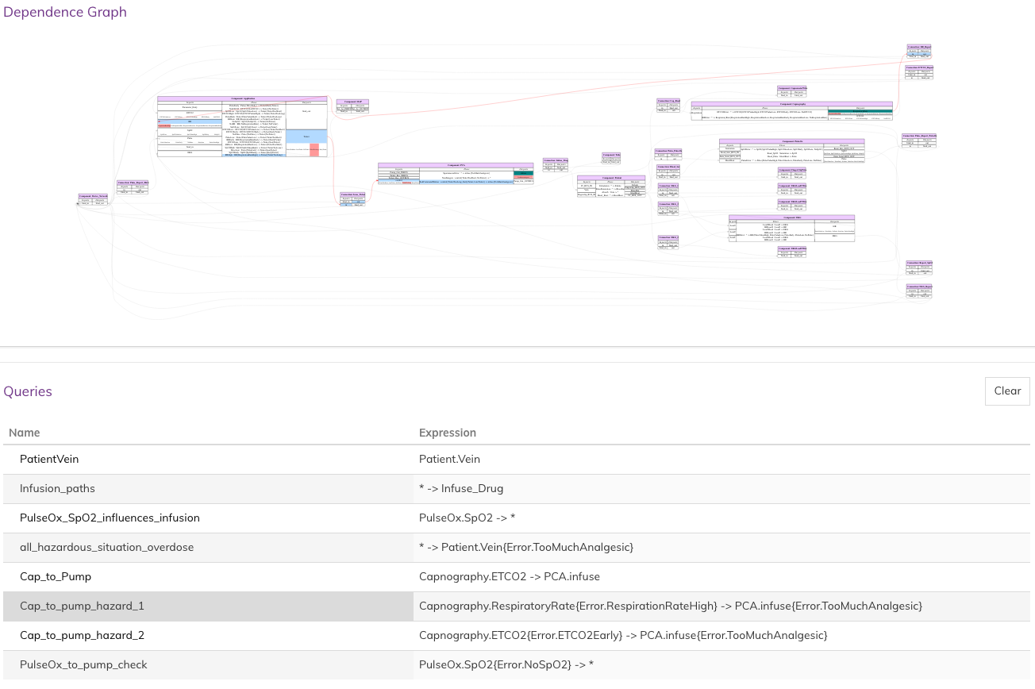
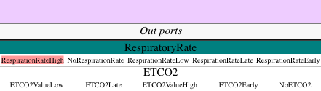
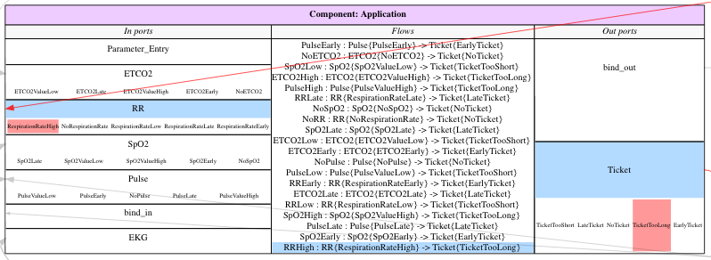
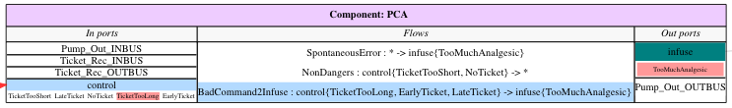
AWAS Analysis
Scenario-1 : If a sensor measures patient’s respiration rate incorrectly, will that be harmful to the patient?
Tool projects the path of error flow through connections and to node “Application”
Tool projects the RespiratoryRate port with the RespirationRateHigh error
The “Application” component transforms the incoming error “RespirationRateHigh” to “TicketTooLong” which is propagated out
The error “TicketTooLong” propagates from Application to the PCA pump, and cause it to overdose the patient
Checking scenario-1:
If Capnography reports patient’s respiratory rate is higher than the actual patient’s respiratory rate, will it lead to overdosing the patient?

Slide 22
Focus of This Talk
Enabling existing model based engineering technology
Interoperable system design
Specification of risk management properties
AADL
+
EMV2
AWAS
Providing tools for incremental design and risk management
Design
Decisions
Risk
Management
Generating reports for strict emerging interoperable medical device standards
ANSI/AAMI IEC80001
ISO 14971
Notes:
21 mins

Slide 23
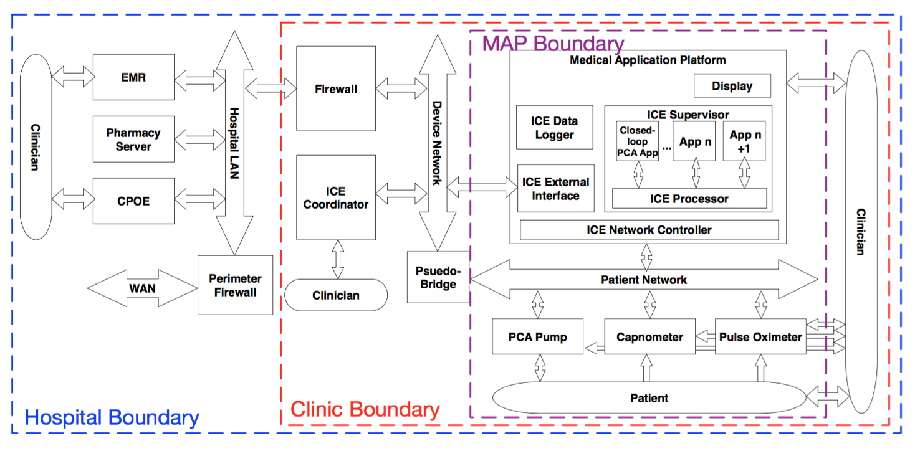
Risk Management
Identification of analysis boundaries
Hospital Organization
Point-of-Care
Full support for risk management (e.g., as needed by IEC 80001) benefits from modeling Point-of-Care (PoC) interoperability as well as the broader hospital network
For this presentation, we will focus on PoC concepts

Slide 24
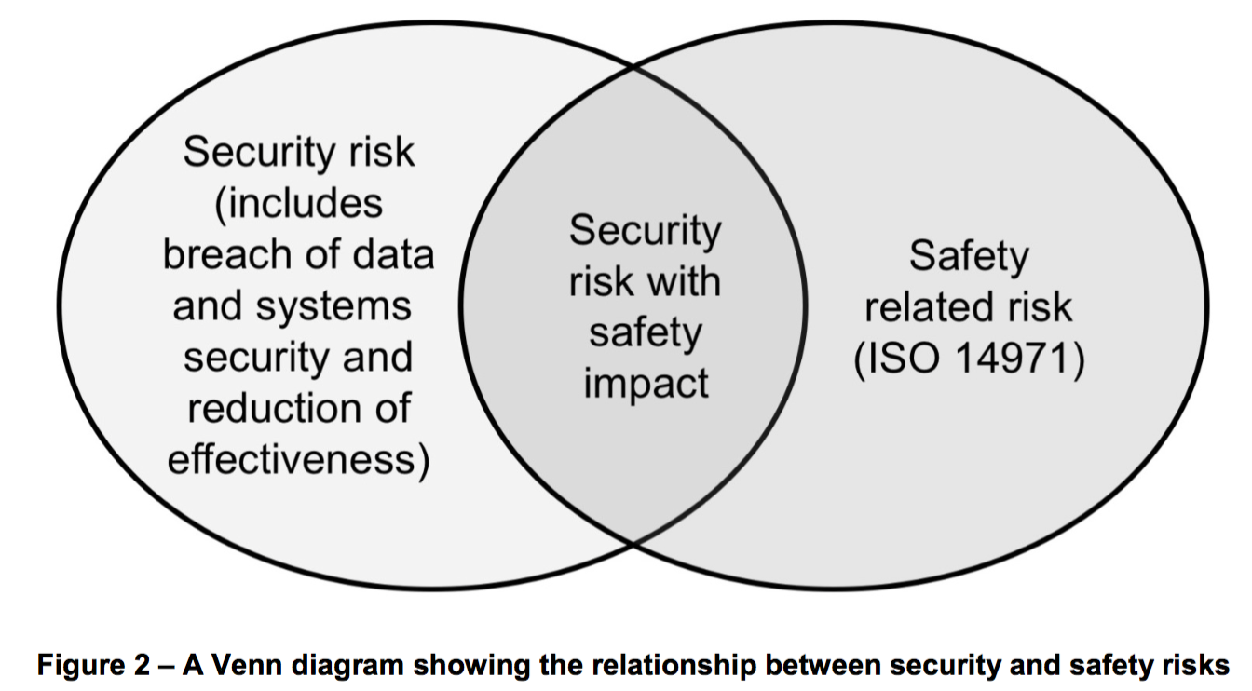
Challenge: How to Integrate Safety and Security Analysis and Risk Management
Notion of harm is confined to the point of care and can be ranked for severity using conventional metrics
Point of Care
Harm: Opioid Over-infusion
Hazardous Situation: Pump continues to infuse opioid when patient’s respiratory health is deteriorating
From AAMI TIR 57 -- Principles for medical device security—Risk management
Security Issues with Safety Impact
attacker injects control commands that lead to hazardous situations
attacker can suppress control commands or reduce availability leading to hazardous situations
Safety Cause (Network Failure): “Halt infusion” command from Interlock logic to pump lost due to network failure
Security Cause (DoS Attack): Attack on network prevents “halt infusion” command from reaching pump
In many cases, there is both a “safety cause” and a “security cause” that have the same observable effect and lead to the same hazardous situation.
Need: How to integrate safety and security analysis and risk management into a common framework?

Slide 25
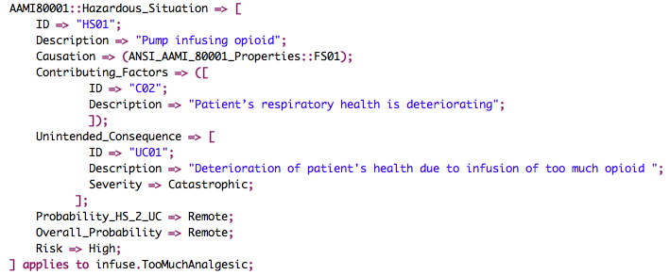
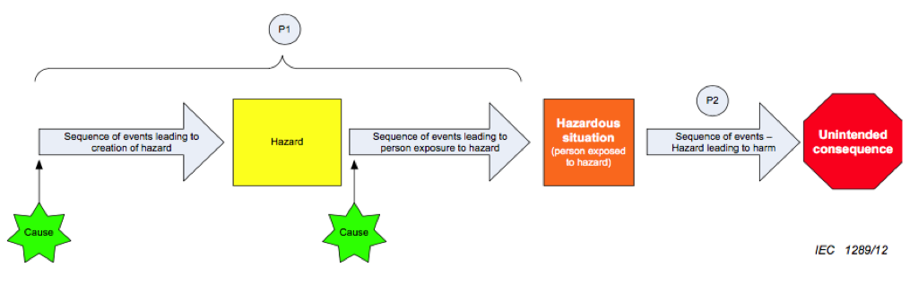
Risk Management Process
Identification of Hazard and Cause
Leads to incorrect
Measurement of SpO2
SpO2
High
App issues incorrect
Ticket
Pump
infuses opioid
patient’s respiratory
health is deteriorating
Opioid
Over-infusion
Faulty
LED
SpO2
High

Slide 26
Conclusion
Benefits
Developers can utilize risk management tool at an early stage
Help manage distributed risk management
Partially automate the generation of regulatory artifacts
Key enablers
Domain specific presentation
Formal architecture description
User controlled analysis
Notes:
23

Slide 27
Questions asked
How to come up with the right error tokens? And, how do you know they captures all the violation of safety property?
How is mine different from Agree?
Why I haven’t tried to tailor Agree to solve the same problem
How is mine compared to FSAP?
What model checker I tried?
Are they explicit state or symbolic ?

Slide 28
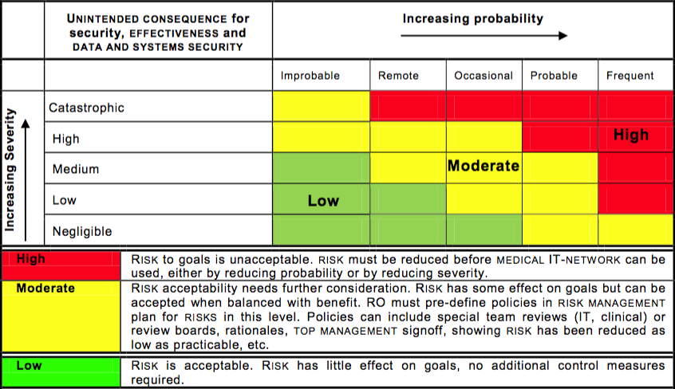
Risk Management Background
Identification of Fundamentals (Top Down Approach)
Identify unintended consequence (Harm / Accident)
UC01: Opioid Over-infusion
Estimate probability and Severity of unintended consequence
Pa01: Remote
S01: Catastrophic
Risk Level
High

Slide 29
Medical Systems of Systems : PCA Interlock
There can be platforms for integrating medical devices into interoperable systems – system of systems of medical device, medical IT systems, and infrastructure components
Patient
Parameters
Devices
EMR Database
PCA Pump
Dosage
Calculator
Clinician /
Monitoring
Pain & Sedation
Scores
Pump Settings
Enable Pump
for safe time window
Enable bolus dose only when ticket present
Device Task controller
Respiratory Rate
Monitor
Monitoring Data +
Alarm Information
PCA Bolus “Enable”
Ticket
Combined PCA Vitals
Monitoring
Status Display
for PCA Monitoring
Application
Aggregated
Monitoring Status
Pulse Oximeter
Monitoring Data +
Alarm Information
Medical Application Platform(MAP) &
Application hosting infrastructure

Slide 30
AADL Model of PCA Interlock
A simplified version of PCA Interlock with one sensor in AADL model view
Platform: MAP
Medical Application Platform &
Hosting infrastructure
Software: App
Computes a ticket value based on SpO2 from PulseOX
Sensor: PulseOX
Senses blood oxygen saturation level from the patient
Connection:
Realized by an IVLine

Slide 31
Risk Management Background
Identification of Hazardous Situations
Hazardous Situation
System state / Set of conditions
Worst-case environmental condition
Unintended Consequence
Hazardous Situation
Pump infusing opioid
Patient’s respiratory health is deteriorating
Opioid Over-infusion

Slide 32
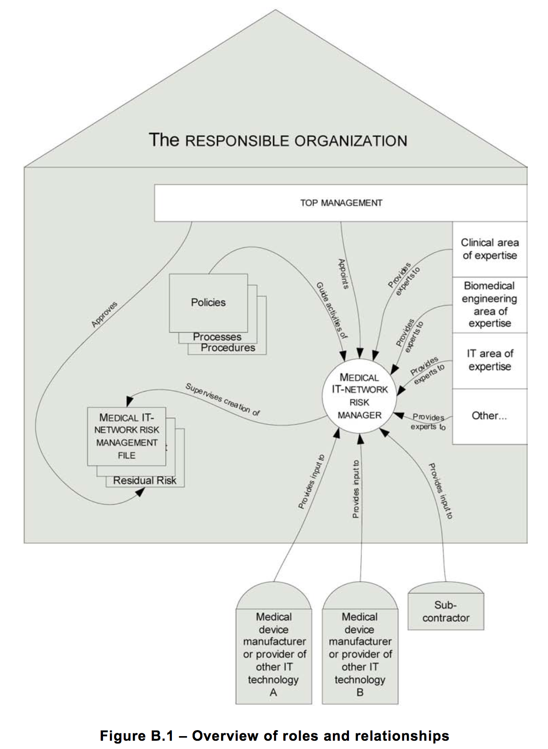
80001 Concepts
80001 Overview of Roles and Relationships
80001 designates the Hospital (Responsible Organization – RO) as primarily responsible for Risk Management associated with network-based integration of medical devices (safety + security).
Responsible Organization (RO) must develop and coordinate
Integration plan (3.4(e))
Disclosure agreements from medical device manufacturers (3.4(d))
Hazard Analysis (3.4(a,b))
Policies, processes, procedures related to network based integration
80001 includes basic requirements on what manufacturers of different categories of components must disclose to RO (3.5,3.6)
Our work aims to support Hospitals + Manufacturers in modeling interfaces & network architectures, providing hazard analysis & RM of integration, providing reports that support disclosures.

Slide 33
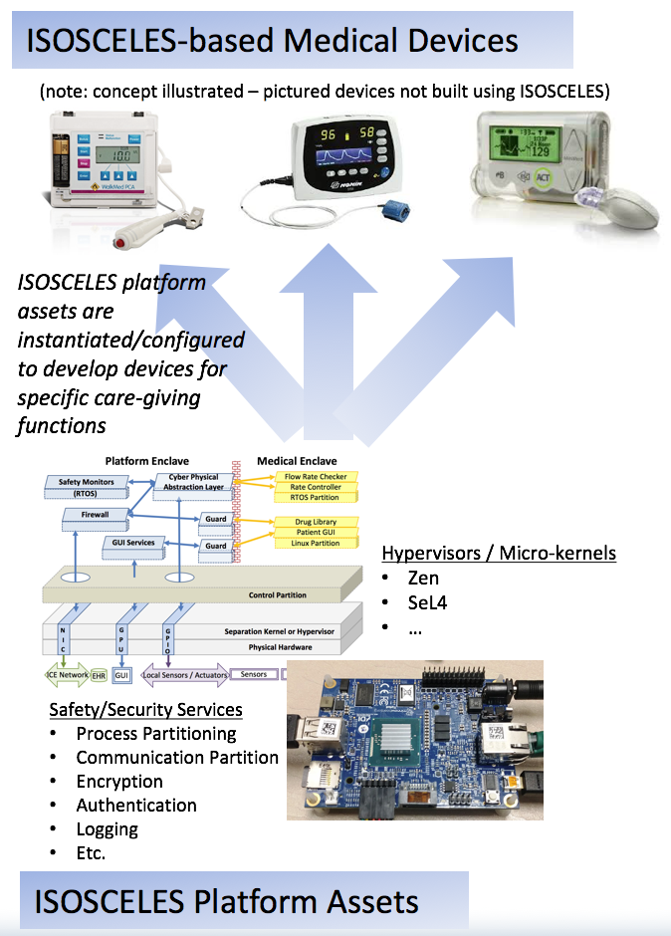
Platforms for Medical Devices
There can be platforms for individual medical devices: The Department of Homeland Security-sponsored ISOSCELES platform is an example...
ISOSCELES – open source medical device platform being developed by Adventium Labs / KSU / U Mich
Provides hardware/software resources and development/assurance artifacts that can be customized to specific medical devices
Part of DHS CPS Security Program – one ISOSCELES goal is “designed in” security

Slide 34
ISOSCELES Platform Features
There can be platforms for individual medical devices: The Department of Homeland Security-sponsored ISOSCELES platform is an example...
Essential properties:
Separation
Determinism
Non-bypassability
Model-driven
Defined interactions
Platform Enclave
OEM Medical Enclave
Safety Monitors
Cyber Physical Abstraction Layer
Flow Rate Checker
(RTOS)
Rate Controller
RTOS Partition
Gateway / Firewall
Guard
Drug Library
Patient GUI
GUI Services
Guard
Linux Partition
Control Partition
Separation Kernel or Hypervisor
Physical Hardware
NIC
GPU
GPIO
ICE Network
EHR
GUI
Local Sensors / Actuators
Sensors
Actuators
Architecture separates networking from safety functions

Slide 35
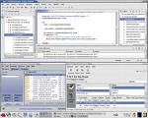
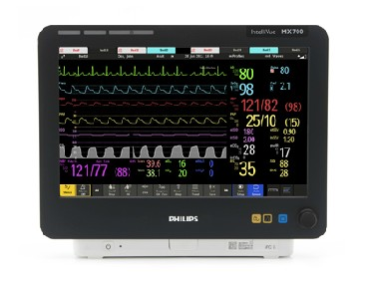
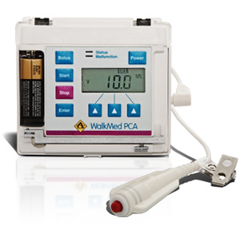
Platforms for Medical Systems of Systems
“Medical Application Platform” is a term that has been introduced to describe this concept…
Clinician Console
Displays
Devices
Apps
Bus
EMR Databases
Computational Platform
A Medical Application Platform is a safety- and security- critical real-time computing platform for…
Integrating heterogeneous devices, medical IT systems, and information displays via communications infrastructure, and
Hosting applications (“apps”) that provide medical utility via the ability to acquire information from and update/control integrated devices, IT systems, and displays
Notes:
[1 min]
Now, in my research, which is a part of the NSF CPS program and the NSF FDA Scholar in residence program, we’re developing this type of platform -- what we call a Medical Application Platform -- along with safety standards for interoperable medical systems.
A Medical Application Platform is a safety- and security- critical real-time computing platform for…
- via a high-assurance network, Integrating multi-vendor devices, medical IT systems, and information displays
- via a computing computing platform, hosting applications (“apps”) that provide medical utility via the ability to acquire information from and update/control these integrated services
The clinician interacts with a console on the platform to select and launch the apps and then interact with them during their execution.

Slide 36
Variety of Applications
Apps that coordinate devices and IT systems can provide a variety of clinical functions
Medical data display and storage
Derived / Smart alarms
Clinical decision support
Workflow automation
Safety interlocks
Closed loop control

Slide 37

Risk Analysis
In a PCA Pump, hazard identification leads us to identify that infused air embolisms are a potential source of harm (hazard), and hazard analysis identifies that harm may be caused in several different hazardous situations
Pump Rate Command
Fluid Sub-System
Operation Sub-System
Rate
Controller
Primary Issues:
What are the hazardous control actions on the patient?
(2) What are the potential causes of each?
Drug
Reservoir
Situation:
Physical properties of drug reservior, tubings, and connections admit small amounts of air
Pump Mechanism
Drug
Flow
Situation:
Failure to clense air in IV tube by priming pump
Harm
IV Drug
Flow
Infusion Settings
Control Panel
Air Embolism
UI
Thread

Slide 38
Risk Evaluation
In a PCA Pump, risk evaluation concludes that both of these situations have unacceptable risk, and therefore controls need to be created for both.
Pump Rate Command
Fluid Sub-System
Operation Sub-System
Rate
Controller
Drug
Reservoir
Situation:
Physical properties of drug reservior, tubings, and connections admit small amounts of air
Planned Control: allocate to medical device with enhanced design for detecting air embolisms & halting infusion
Pump Mechanism
Drug
Flow
Situation:
Failure to clense air in IV tube by priming pump
Planned Control: allocate to clinician via instructions for use on proper pump priming
Harm
IV Drug
Flow
Infusion Settings
Control Panel
Air Embolism
UI
Thread

Slide 39
Risk Control Design
In a PCA Pump, designing/implementing an air embolism risk control may involve an air bubble sensor, an analyzer to determine if the size/history is sufficient to represent a fault condition, responses to halt the pump and notify the operator
Pump Rate Command
Fluid Sub-System
Safety Sub-System
Operation Sub-System
Rate
Controller
Drug
Reservoir
Pump Fault Manager
Halt Pump Command
Pump Mechanism
Embolism Fault
Set Alarm Condition
Drug
Flow
Bubble Size Data
Pump Alarm Manager
Bubble
Sensor
Bubble
Analyzer
Logging
Harm
IV Drug
Flow
Infusion Settings
Control Panel
Air Embolism
UI
Thread

Slide 40
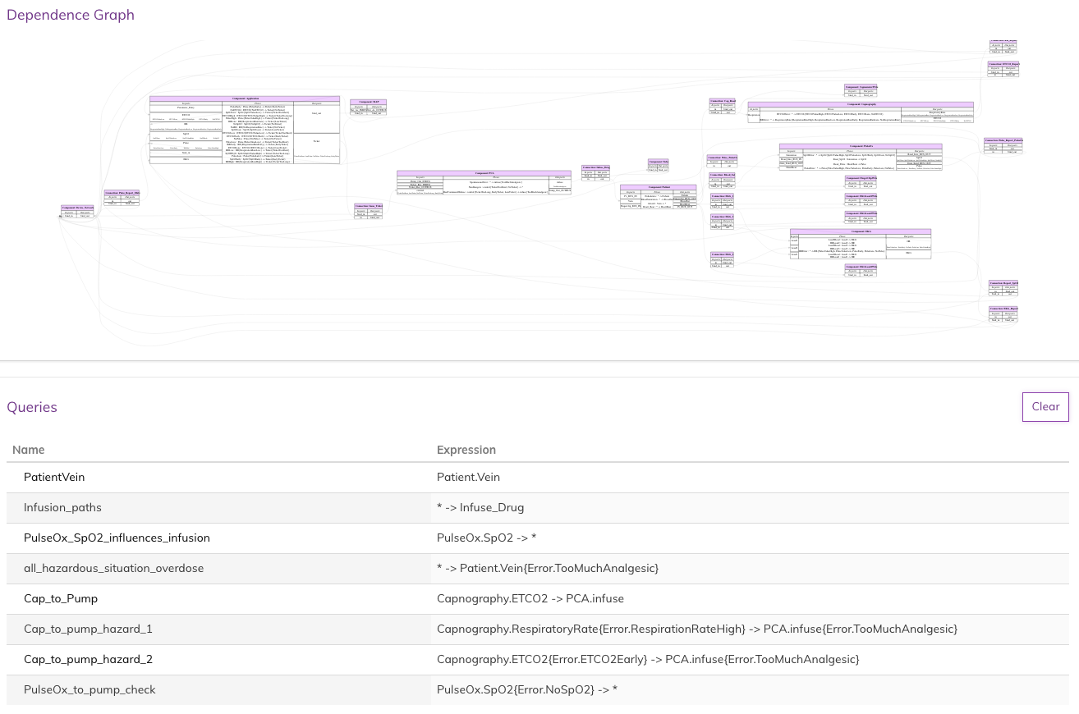
AWAS Analysis
Dependence Graph
Node : AADL Component + Connection
Edge : Infallible links
Queries
- Assist in exploring the model
- Expose unintuitive hazardous behavior
Simple query to identify a port in the graph
Reachability Query:
Highlights all the nodes from which node “Infuse_Drug” can be reached
Reachability Query:
Highlights all the ports that are influenced by port “SpO2” of component “PulseOX”

Slide 41
SSCATE Architecture Re-visited
AADL Instance Model to AWAS IR
Extraction of model elements relevant to SSCATE Analysis into AWAS IR
AADL Model
OSATE
Instance Model
Artifacts
&
Reports
Queries
&
Witness
Querying
Querying language & APIs understands AADL constructs used as inputs from AWAS IR
Queries and results are stored, to use it in another query or to generate reports
AADL to AWAS-IR
Translator
AWAS
IR
Transforms AWAS IR to AWAS Graph
Graph G(Nodes, Edges):
Nodes N = Components & Connections
Edges E = Infallible link between Nodes
Analysis Engine
Graph
Translator
Query
Engine
AWAS
API
AWAS
Dependency
Graph
Analysis:
Error Propagation State Reachability
Analysis
Graph nodes may be in different abstract levels depending on the error modeling information provided in the AADL EMV2
AWAS Graph
Graph Nodes may be in different abstract levels depending on the error modeling information provided in the AADL EMV2
Notes:
Questions:
Is report generated from AWAS IR or AADL?
AWAS IR cannot be omitted why?
- Just node names are not enough for different kinds of queries (error tokens and state space are necessary)
- Queries capable of filtering on AADL / AWAS properties (to be implemented)
R

Slide 42
AADL:EMV2
Annotation Model with Error Types
Component
C
Late
ValueError
p1
p2
Late
Error Propagation
port
Error propagation and containment are associated with interaction points eg: ports, bus, binding points etc.
Error source: component in which error originates
Error path and sink specifies how components respond to incoming errors

Slide 43
AADL:EMV2
Annotation Model with Error Types
Component
C
Late
ValueError
p1
p2
Late
Error Propagation
port
Error propagation and containment are associated with interaction points eg: ports, bus, binding points etc.
Error source: component in which error originates
Error path and sink specifies how components respond to incoming errors

Slide 44
AADL:EMV2
Composite Behavior
Sensors
PulseOX
Operational
Failed
PulseOx.Failed and Capnograph.Failed -> Failed
Operational
Failed
Capnography
Top-level
System
Operational
Failed
Error behavior of a system in terms of its subsystem behavior
Abstract the sub-component behavior

Slide 45
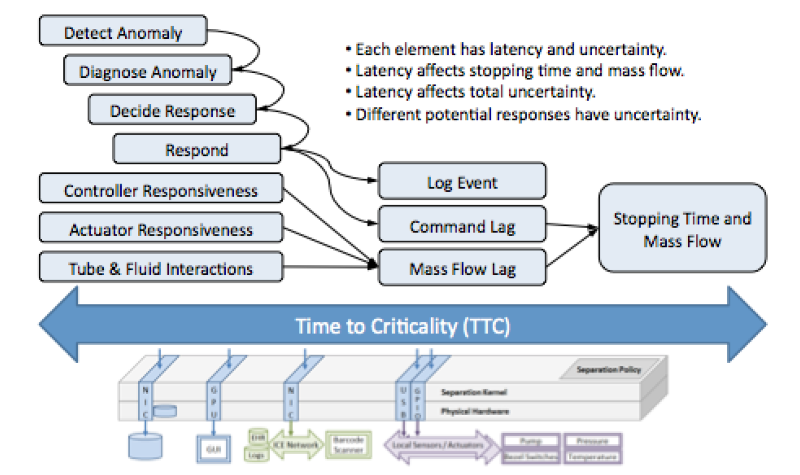
Risk Control Themes

Slide 46
Risk Control Themes
Our model-based engineering approach will emphasize decomposing a risk control into the following elements: (1) sense/detect, (2) diagnose, (3) determine response, (4) respond
Pump Rate Command
Fluid Sub-System
Safety Sub-System
Operation Sub-System
Determine
Response
Rate
Controller
Drug
Reservoir
Pump Fault Manager
Halt Pump Command
Respond /
Control
Pump Mechanism
Embolism Fault
Set Alarm Condition
Drug
Flow
Bubble Size Data
Pump Alarm Manager
Detect
Bubble
Sensor
Bubble
Analyzer
Logging
Respond /
Notify
Diagnose
Harm
IV Drug
Flow
Infusion Settings
Planned Control: allocate to medical device with enhanced design for detecting air embolisms & halting infusion
Control Panel
Air Embolism
UI
Thread

Slide 47
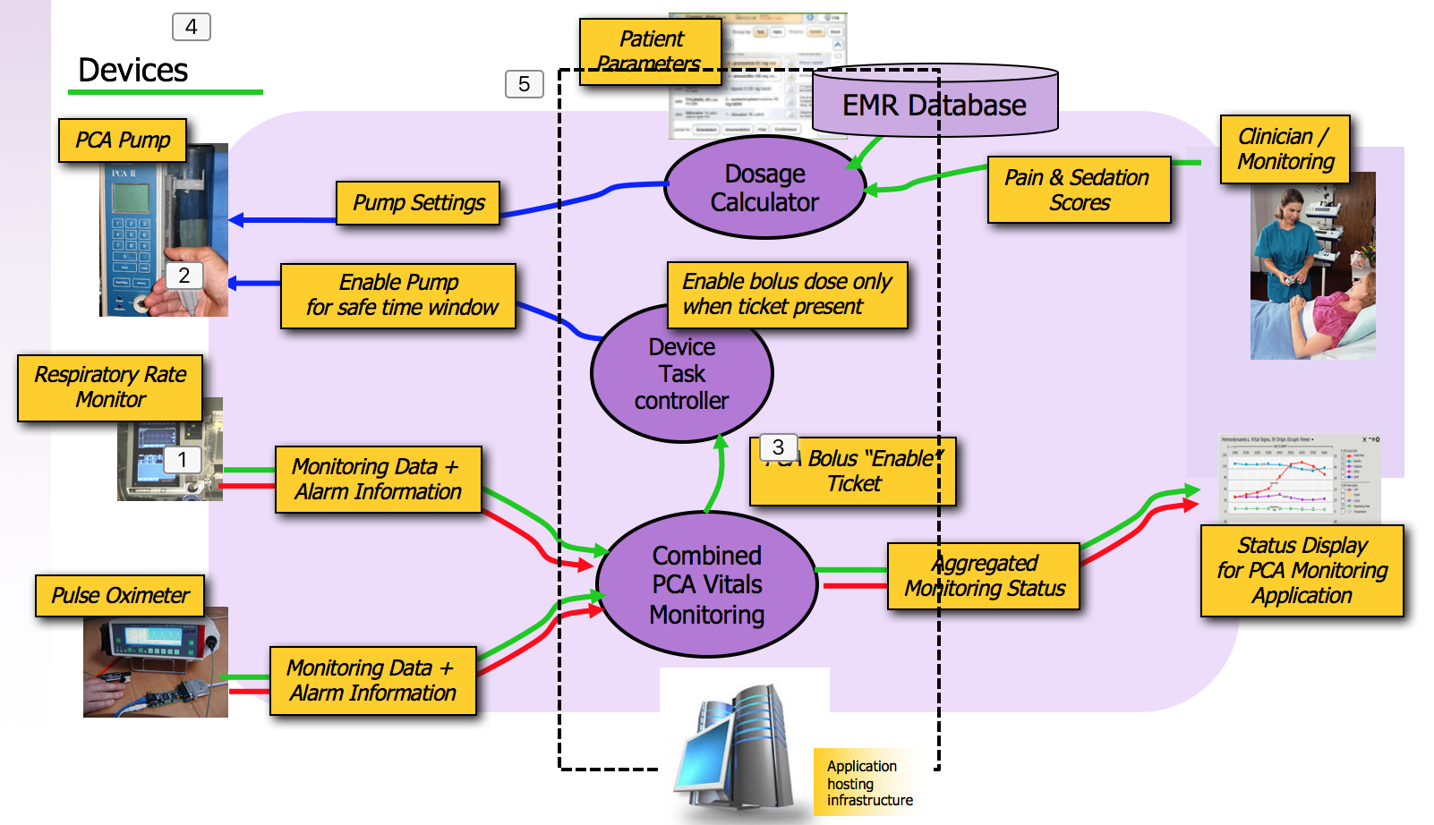
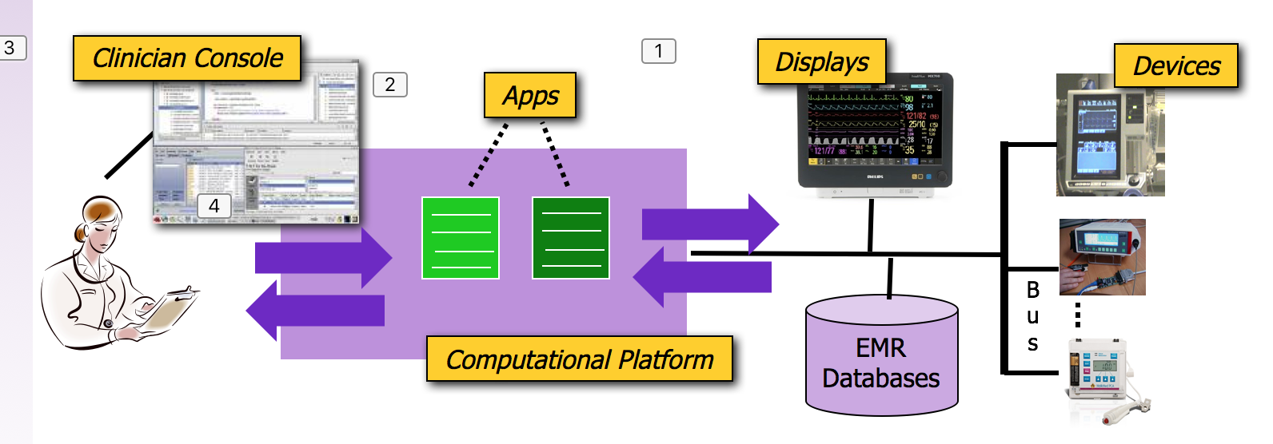
Challenges
What are some of the characteristics of medical platforms and medical systems of systems that will require better hazard analysis and risk management solutions?

Slide 48
Challenges: Platform Architectures
Supervisor
Envisioned platform-based systems, when built following proper systems engineering principles have architectures that must be precisely defined
App
A₁
App
A₂
…
App
A_{n}
ASTM Standard F2761-2009 for ICE defines a high-level architecture and functional concept
Subsequent standards from AAMI Interoperability Working Group are intended to provide specific functional and interfacing requirements for components
Provides/supports reusable assets, e.g.,
Supervisor/Network controller infrastructure
Reusable interoperable medical devices
ASTM F2761 is one of a collection of standards related to interoperability recognized by the FDA, and the only one of the collection that address architectural concerns
ICE App Code Language / Virtual Machine
Network Controller (NC)
ICE EI Interface Description Language
Ice Equipment
Interface (EI)
I₁
Ice Equipment
Interface (EI)
I₃
EI
Adapter
Native
EI-Compliant
Physical
Device
EI
Adapter
Need: Risk management requires rigorous description of platform/system architectures that adequately capture interoperability solutions.
Physical
Device
Physical
Device

Slide 49
Key Solution Approaches and Benefits to Stakeholders
Capture architecture and interfaces in formal modeling language
Benefits: clarifies boundaries/responsibilities, avoids integration mismatches, provides scaffolding for detailed analysis information
Perform risk analysis using architecture integrated annotations and automated tool support
Benefits: strong traceability/consistency, automated discovery of dependences and causality chains
Document risk controls using architecture-integrated annotations
Benefits: directly links causes/hazards to risk controls, guides testing and evaluation
Use automated report generation to generate documentation supporting risk management disclosures and third-party regulatory review
Benefits: report information with multiple views and abstractions, strong traceability to architecture, implemented controls, and analysis

Slide 50
Architecture Scope
Hospital Organization
Point-of-Care
Full support for risk management (e.g., as needed by IEC 80001) benefits from modeling Point-of-Care (PoC) interoperability as well as the broader hospital network
For this presentation, we will focus on PoC concepts

Slide 51
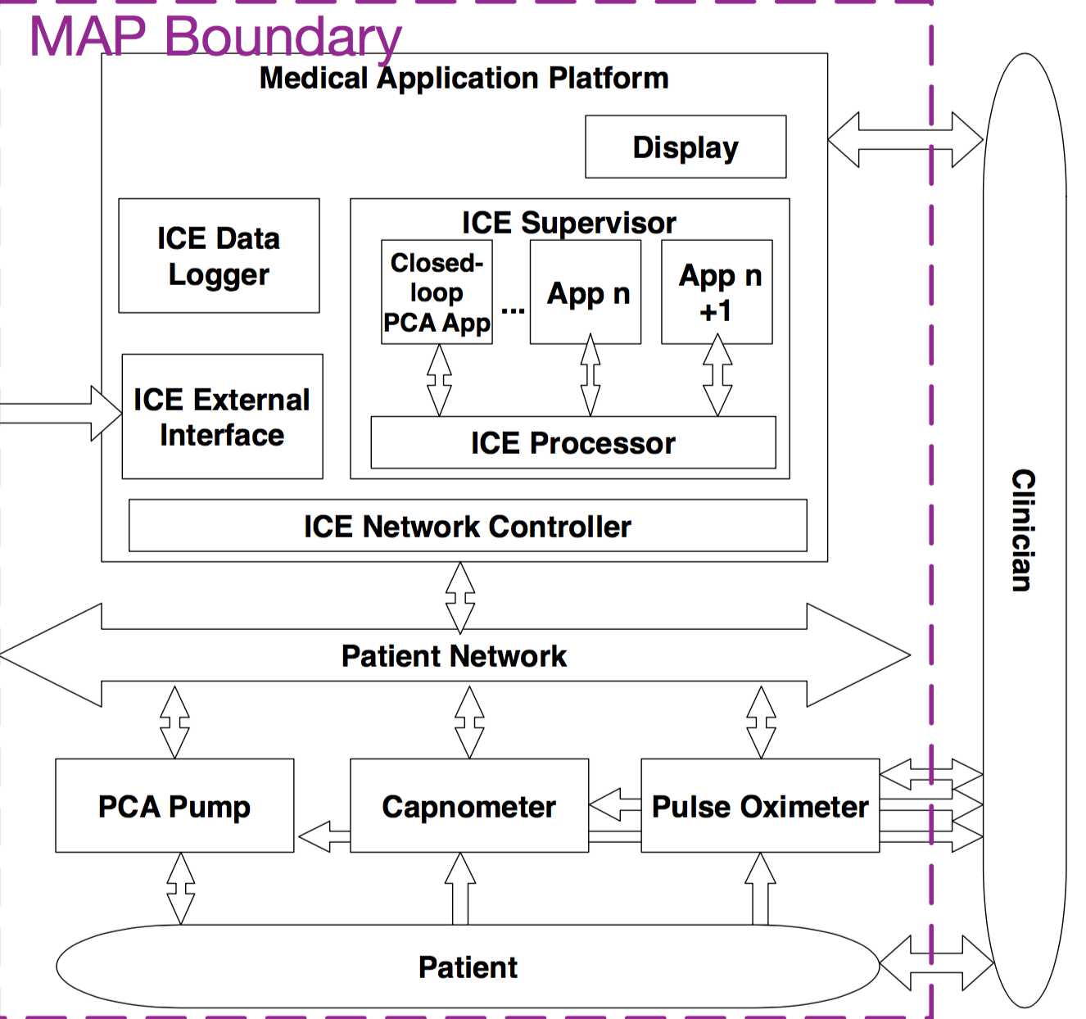
Stakeholder Responsibilities
Platform (MAP)
Manufacturer
App
Manufacturer
PCA Pump Manufacturer
Capnometer
Manufacturer
Pulse Oximeter
Manufacturer

Slide 52
SSCATE Process Overview
Build System Model
…using Architecture Analysis and Design Language (AADL)
Include supporting context: networks, clinicians
Define notions of harm, hazards, hazardous situations
Model dependences, focusing on control loops
Sensors, actuators, controllers, connections (high-lighting interoperability)
For each component / link along control path:
What conditions (faults, errors) can cause the hazards? – include security
What constraints can mitigate the hazards? And how can these be mapped into risk control design?
How do the hazards / constraints propagate to other components?
Produce security and safety reports and information for disclosure agreements that can be shared between stakeholders
We will illustrate these concepts using a simplified model of the interoperable system.

Slide 53
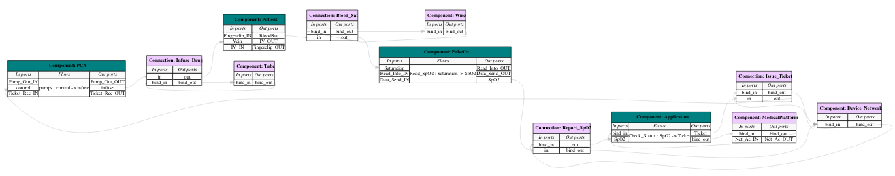
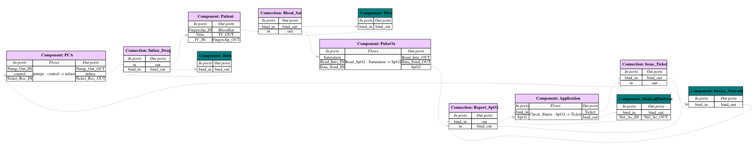
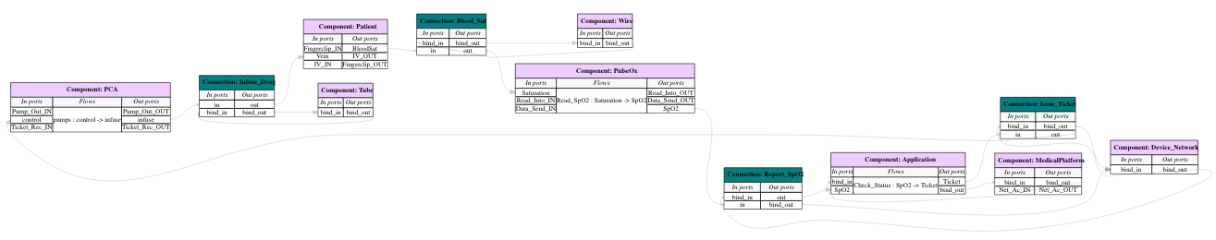
PCA MSIS Model Graphical Overview
Insert graphical view of the the model – showing both hardware / software and bindings
Logical Components
Hardware Components
Connections
Bindings & Infallible links

Slide 54
PCA MSIS Model Graphical Overview
Insert graphical view of the the model – showing both hardware / software and bindings

Slide 55
Textual Definition of Top-Level Components
AADL supports a textual representation that facilitates systems engineering – model elements drawn from common system features, types (with type checking) support consistency and facilitate integration
system implementation PCA_PulseOx.impl
subcomponents
-- Logical Components
PCA: device PCA.impl; --PCA pump
PulseOx: device PulseOx.impl; --Pulse Oximeter
App: process Application.impl; --Control Application
-- Physical/Resource Layer
MAP: processor PCA_Example_Hardware::MAP.impl; --Medical Application Platform
Device_Network: bus PCA_Example_Hardware::Device_Network;
Tube: bus PCA_Example_Hardware::Tube; --IV tube from PCA pump to patient
Wire: bus PCA_Example_Hardware::Wire; --Fingerclip wire from patient to pulse oximeter
-- Immediate System Context
Patient: system Patient.impl; --Patient

Slide 56
Modeling Data/Control Flow Across Interoperability Pathways
AADL component connections model the interoperability pathways between components. These reflect the dependences and error propagation pathways that we will consider in our model-based hazard analysis.
Connections modeling device / app interoperability where we will need to consider interoperability failues in our hazard analysis
connections
Blood_Sat: port Patient.BloodSat -> PulseOx.Saturation;
Report_SpO2: port PulseOx.SpO2 -> App.SpO2;
Issue_Ticket: port App.Ticket -> PCA.control;
Infuse_Drug: port PCA.infuse -> Patient.Vein;

Slide 57
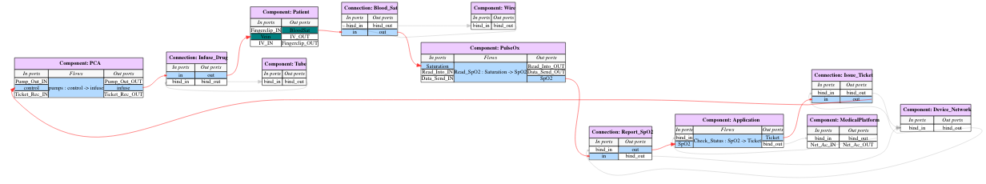
Modeling Data/Control Flow Across Interoperability Pathways
AADL flows let of declare data/control paths of interest (intra-component, inter-component, and end-to-end flows). Below is shown an end-to-end flow from the patient’s sensed physiological parameter (oxygen saturation), through the main control loop of the system, back to the infusion of opioid into the patient.
flows
Control_Loop: end to end flow Patient.BloodSaturation ->
Blood_Sat ->
PulseOx.Read_SpO2 ->
Report_SpO2 ->
App.Check_Status ->
Issue_Ticket ->
PCA.Pump ->
Infuse_Drug ->
Patient.Absorb;

Slide 58

Modeling Data/Control Flow Across Interoperability Pathways
AADL flows let of declare data/control paths of interest (intra-component, inter-component, and end-to-end flows). Below is shown an end-to-end flow from the patient’s sensed physiological parameter (oxygen saturation), through the main control loop of the system, back to the infusion of opioid into the patient.
flows
Control_Loop: end to end flow Patient.BloodSaturation ->
Blood_Sat ->
PulseOx.Read_SpO2 ->
Report_SpO2 ->
App.Check_Status ->
Issue_Ticket ->
PCA.Pump ->
Infuse_Drug ->
Patient.Absorb;

Slide 59
Hazard Analysis
Annotating our Architectural Model
Feedback or control
action is provided
in an unsafe way
How would the message be unsafe?
What hazard would be caused?
What constraint would be violated?
What should the occurrence be named?
What would cause this to occur?
How can this occurrence be compensated for?
Notes:
13.00 -- 13.45 [45s]
Intro: “So here we are again at our diagrammatic view of the system. There are three main MDD concepts that AADL supports…”
* Aggregation concepts (hierarchical nature), once I have these, I need
* Communication concepts / patterns (sync vs. async, etc.), once I have these, I need
* Computation aspects (periodic vs aperiodic), once I have these, I need
Outro: “Now let’s look at how all this comes together by walking through the steps I would take as an app developer””

Slide 60

Hazard Analysis
Annotating our Architectural Model
How would the message be unsafe?
What hazard would be caused?
What constraint would be violated?
What should the occurrence be named?
What would cause this to occur?
How can this occurrence be compensated for?
We’ll come back to these
two in a moment.
Notes:
13.00 -- 13.45 [45s]
Intro: “So here we are again at our diagrammatic view of the system. There are three main MDD concepts that AADL supports…”
* Aggregation concepts (hierarchical nature), once I have these, I need
* Communication concepts / patterns (sync vs. async, etc.), once I have these, I need
* Computation aspects (periodic vs aperiodic), once I have these, I need
Outro: “Now let’s look at how all this comes together by walking through the steps I would take as an app developer””

Slide 61

Report Generation Development
AADL Component
Architecture
with Hazard
Annotations
Development of component architecture using AADL / OSATE2
Addition of Hazard Analysis Annotations
Automatic generation of STPA-Styled Hazard Analysis Report
Automatic report generation
Notes:
18.45 -- 19.30 [45s]
Intro: “We’ve already done the first, and hardest, step: the specification of the architecture of my app and components in AADL”
Outro: “In fact, each element that we looked at has a pretty clear correspondence to a medical application platform concept”
----- Meeting Notes (10/13/14 15:47) -----
Leveson's work does not include a formal architecture description. What do we get with one?
1. Automation -- Populating control actions x guidewords -- in a traditional model, someone has to mine the system, and then maintain it, and there's no tool
2. Traceability -- with fault testing from hazard analysis description. If you claim to compensate for something, we can generate a test for it.
3. The "Not MS Word Slide"
4. A diagram that shows the error flows in the model correspond to the flows in the code, corresponding to fault injection testing

Slide 62
Hazard Analysis
Annotating our Architectural Model
Feedback or control
action is provided
in an unsafe way
What specific fault will result?
What control action will be affected?
Notes:
13.00 -- 13.45 [45s]
Intro: “So here we are again at our diagrammatic view of the system. There are three main MDD concepts that AADL supports…”
* Aggregation concepts (hierarchical nature), once I have these, I need
* Communication concepts / patterns (sync vs. async, etc.), once I have these, I need
* Computation aspects (periodic vs aperiodic), once I have these, I need
Outro: “Now let’s look at how all this comes together by walking through the steps I would take as an app developer””

Slide 63
Annotating our Architectural Model
Inside the AADL System Component
What channel will be affected?
What specific fault will result?
What can we do with our
model + specific
fault information?
Notes:
13.00 -- 13.45 [45s]
Intro: “So here we are again at our diagrammatic view of the system. There are three main MDD concepts that AADL supports…”
* Aggregation concepts (hierarchical nature), once I have these, I need
* Communication concepts / patterns (sync vs. async, etc.), once I have these, I need
* Computation aspects (periodic vs aperiodic), once I have these, I need
Outro: “Now let’s look at how all this comes together by walking through the steps I would take as an app developer””

Slide 64
Hazard Model in AADL
Occurrence : record (
Kind:
Hazard:
ViolatedConstraint:
Title:
Cause:
Compensation:
Impact:
) applies to (port connection);

Slide 65
Example PCA Pump Hazard
MAP_Error_Properties::Occurrence => [
Kind => AppliedTooLong;
Hazard => PatientOD;
ViolatedConstraint => DontODPatient;
Title => "Network Drop";
Cause => "Network drops out, leaving the pump running normally when it should be shut off";
Compensation => "Pump-normal commands have a maximum time, after which the pump runs at the KVO rate";
Impact => reference(InadvertentPumpNormally);
] applies to pumpcommand_logic;

Slide 66
Hazard Analysis
Annotating the Architectural Model
The fault is traced
to its source
component / port
Notes:
13.00 -- 13.45 [45s]
Intro: “So here we are again at our diagrammatic view of the system. There are three main MDD concepts that AADL supports…”
* Aggregation concepts (hierarchical nature), once I have these, I need
* Communication concepts / patterns (sync vs. async, etc.), once I have these, I need
* Computation aspects (periodic vs aperiodic), once I have these, I need
Outro: “Now let’s look at how all this comes together by walking through the steps I would take as an app developer””

Slide 67

Hazard Analysis
Specification Step 1: Propagation
Port the fault will propagate on
Specific Fault
Direction of the propagation
Notes:
13.00 -- 13.45 [45s]
Intro: “So here we are again at our diagrammatic view of the system. There are three main MDD concepts that AADL supports…”
* Aggregation concepts (hierarchical nature), once I have these, I need
* Communication concepts / patterns (sync vs. async, etc.), once I have these, I need
* Computation aspects (periodic vs aperiodic), once I have these, I need
Outro: “Now let’s look at how all this comes together by walking through the steps I would take as an app developer””

Slide 68
Hazard Analysis
Annotating the Architectural Model
Anything missing?
There are two missed error propagations!
Notes:
13.00 -- 13.45 [45s]
Intro: “So here we are again at our diagrammatic view of the system. There are three main MDD concepts that AADL supports…”
* Aggregation concepts (hierarchical nature), once I have these, I need
* Communication concepts / patterns (sync vs. async, etc.), once I have these, I need
* Computation aspects (periodic vs aperiodic), once I have these, I need
Outro: “Now let’s look at how all this comes together by walking through the steps I would take as an app developer””
----- Meeting Notes (10.14.14 12:56) -----
animate

Slide 69

Hazard Analysis
OSATE Remembers A Neglected Connection
Notes:
13.00 -- 13.45 [45s]
Intro: “So here we are again at our diagrammatic view of the system. There are three main MDD concepts that AADL supports…”
* Aggregation concepts (hierarchical nature), once I have these, I need
* Communication concepts / patterns (sync vs. async, etc.), once I have these, I need
* Computation aspects (periodic vs aperiodic), once I have these, I need
Outro: “Now let’s look at how all this comes together by walking through the steps I would take as an app developer””

Slide 70

Hazard Analysis
Interaction between Report and Model
4. Developer creates supporting occurrence property, considers alternative impacts of hazard
1. Report indicates analysis incomplete
Bottom Up
Top Down
3. Tool highlights unconsidered propagation paths
2. Developer creates and supporting EMV2 annotations
Notes:
----- Meeting Notes (10/13/14 15:47) -----
Change actor behind popups to be report / human:
1. "Report indicates analysis incomplete"
2. "Developer creates and supporting EMV2 annotions"
3. "OSATE highlights unconsidered propagation paths"
4. "Developer creates supporting occurrence property, considers alternative impacts of hazard"

Slide 71

SSCATE Model Support and Analysis Tools
AADL System Model
Model Translation
Dependency Graph
Logical Model
Physical Model
Hazards and Mitigations
Support Context
(other networks, clinicians, etc)
Error Behavior
Library
Analysis Tools
Reachability
Hazard Propagation
Error Propagation
Mitigation Checking
Iterative
Analysis
Model Building Tools
Component Generation
Hazard Generation
Mitigation Association
Reporting Tools
Report Generation
Path Visualization
Safety and Security Risk Reports

Slide 72
Hazard Report Format
Fundamentals
System Architecture
Accidents & Hazards
Safety Constraints & Control Actions
Unsafe Control Actions
Cause
Compensation
Effected Components
Insecure Control Actions
Cause
Compensation
Effected Components
Summary
Summary of Unsafe and Insecure Actions
Summary of Mitigations

Slide 73



Integration Issue Analogy
Individual chair
Safe to sit
Tested and verified in various scenarios
But, not tall enough
Let’s stack more of the safe chairs
Is it safe to sit now?
Weight carried by the bottom most chair may exceed the safety limit

